Slide 1


INF 112
OBLIG 4
GROUP 6
TEAM PRESENTATION

Slide 2







GRUPPE 6
Sverre – Code
Loc - Graphics
Benjamin – SQL
Eirik – Code
Stian – AI & Version control
Vegard – Documentation & UI
Robin E – Sound
Robin G – UI
1
of
6

Slide 3
RESULTS &
CHALLENGES
From Maven to Gradle
Improved use of issues
UI competence
Role entrenchment
2
of
6

Slide 4
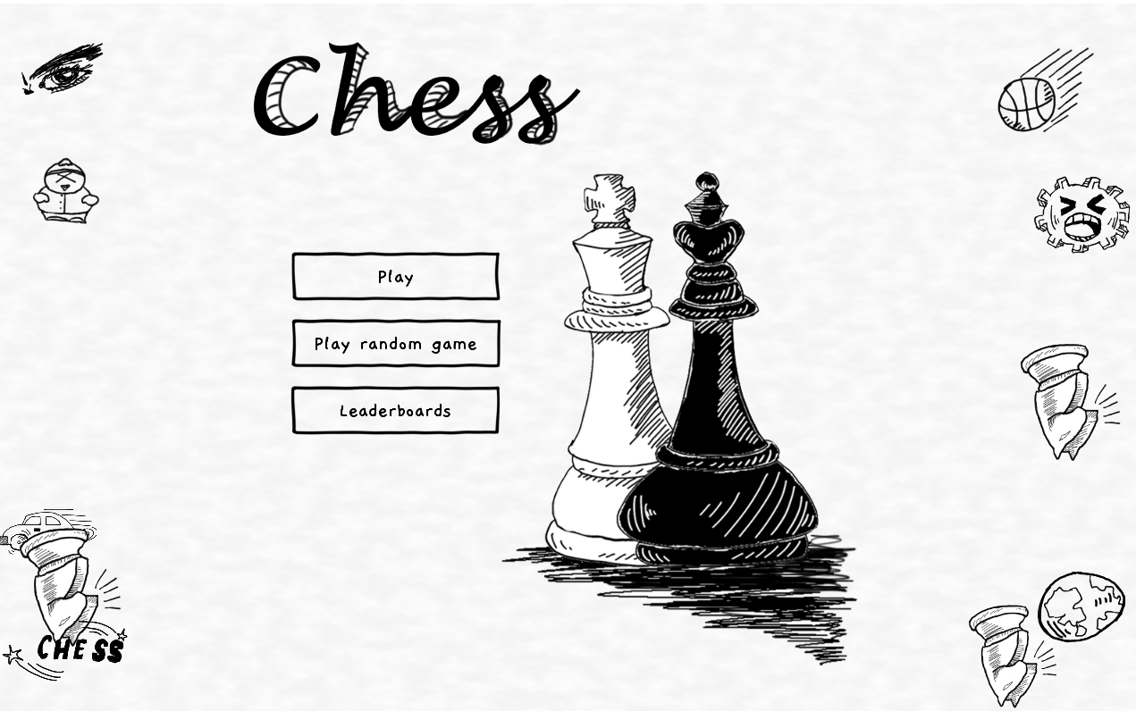
3
of
6

Slide 5
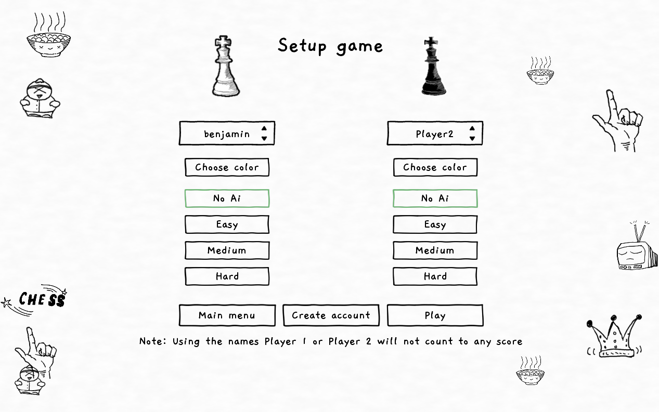
5
of
8

Slide 6
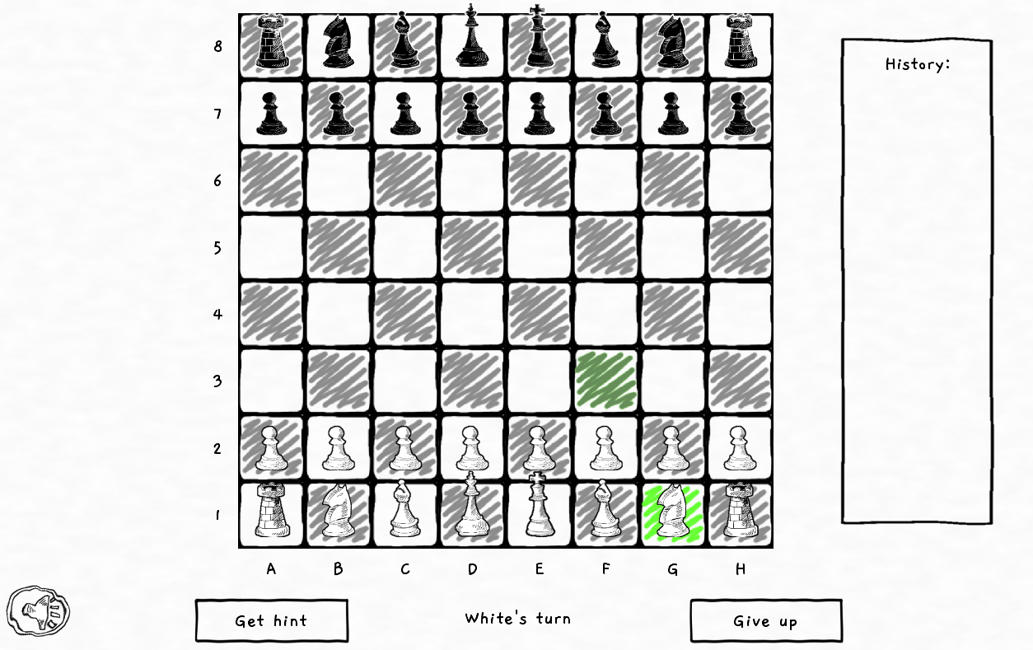
5
of
8

Slide 7
DEMOVIDEO
6
of
9

Slide 8
Retrospective
Next Iteration
Get better at the tools we are using
Shift away from role-based system
8
of
8

Slide 9
THANK YOU

